Slide 1
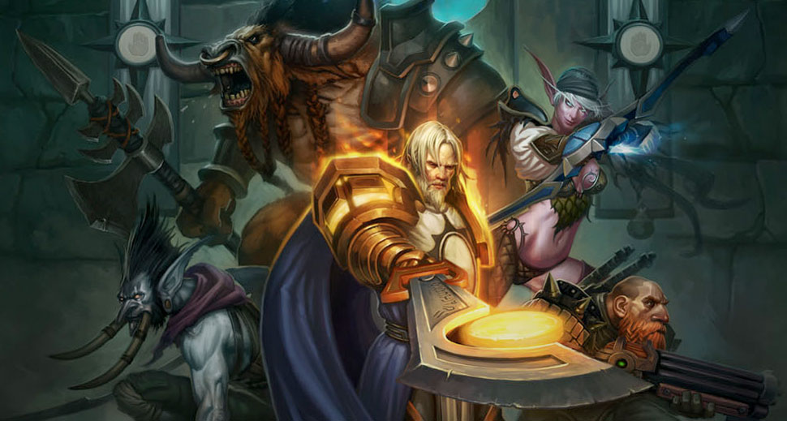
GA 3331 – Game Prototyping
Week 2
Game Design – In Depth

Slide 2
Homework!

Slide 3
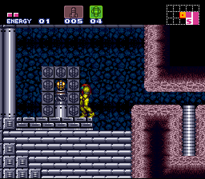
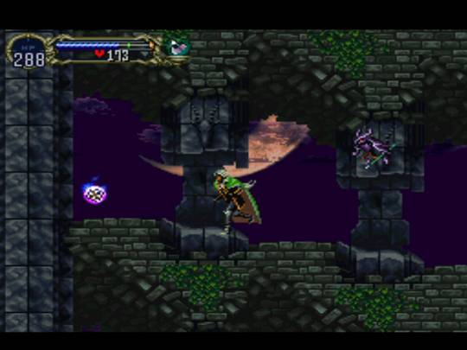
What is good game design?
What is game design?
The process of creating the content and rules for a game.
The process of creating goals that a player feels motivated to reach
The process of creating rules that allow meaningful decisions

Slide 4
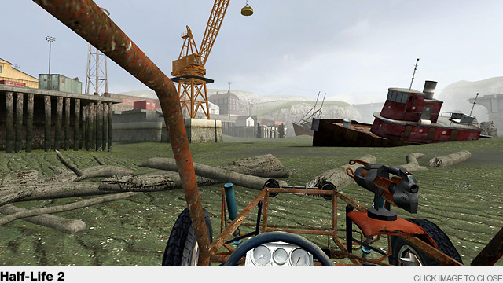
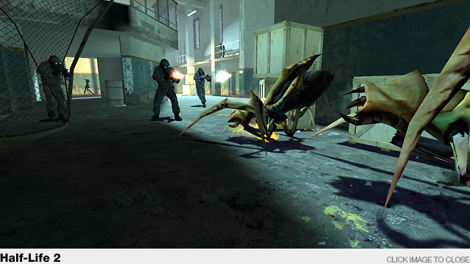
Good game design
Player-centric.
Motivate the player.
Think from the player’s viewpoint.
What’s this game about?
How do I play?
How do I win?
Why do I want to play?
What things do I need to do?

Slide 5
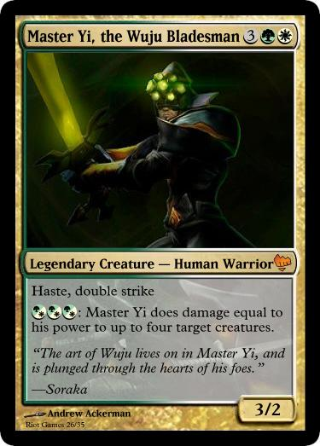

Prototyping exercise
Let’s make a League of Legends card game!
+

Slide 6
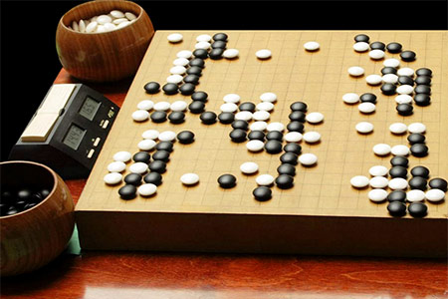
What game design is not
Game design is not programming
Game design is not making art
Game design goes beyond technology

Slide 7
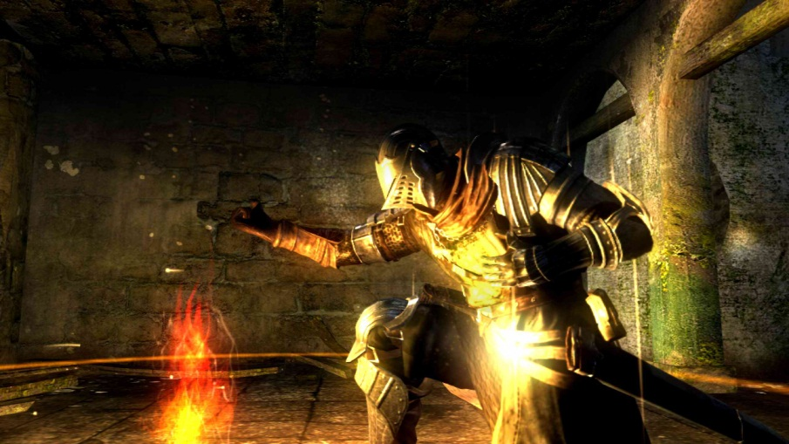
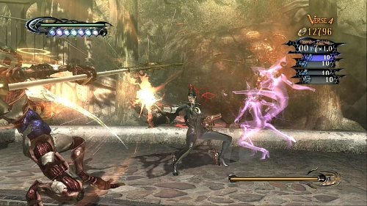
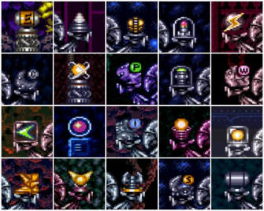
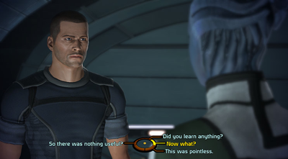
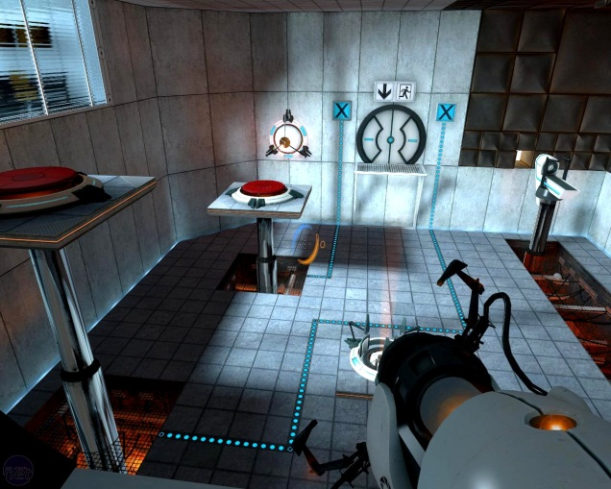
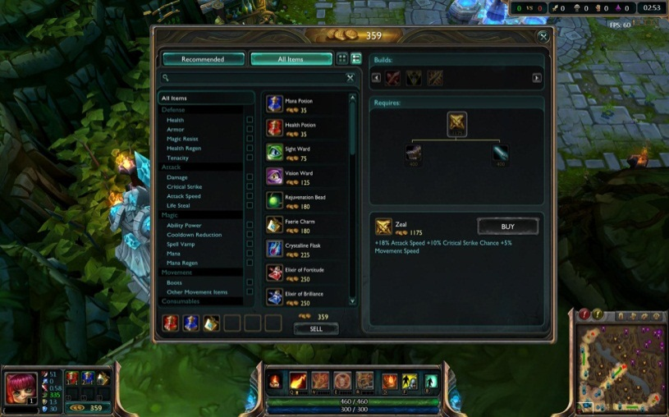
Types of design
World design
System design
Content design
Game writing
Level design
User Interface

Slide 8
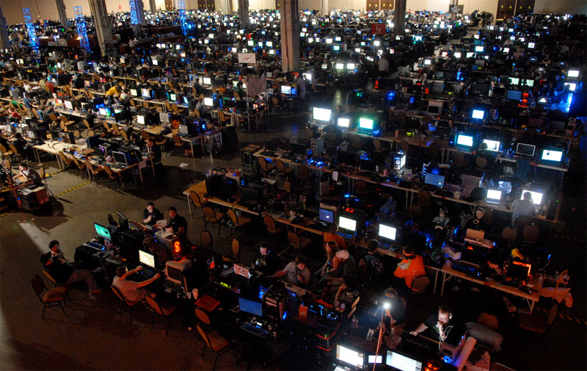
What is a game?
An activity with rules.

Slide 9
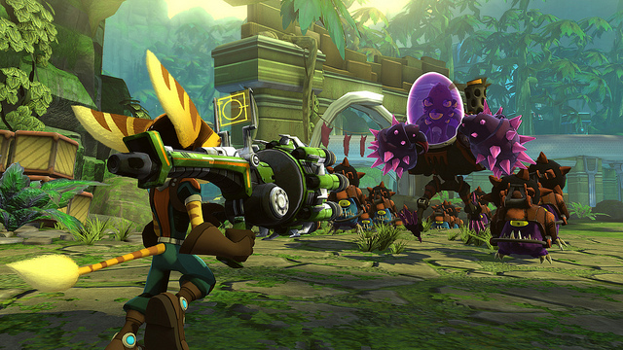
What is the core of a game?
The single thing gameplay is about

Slide 10


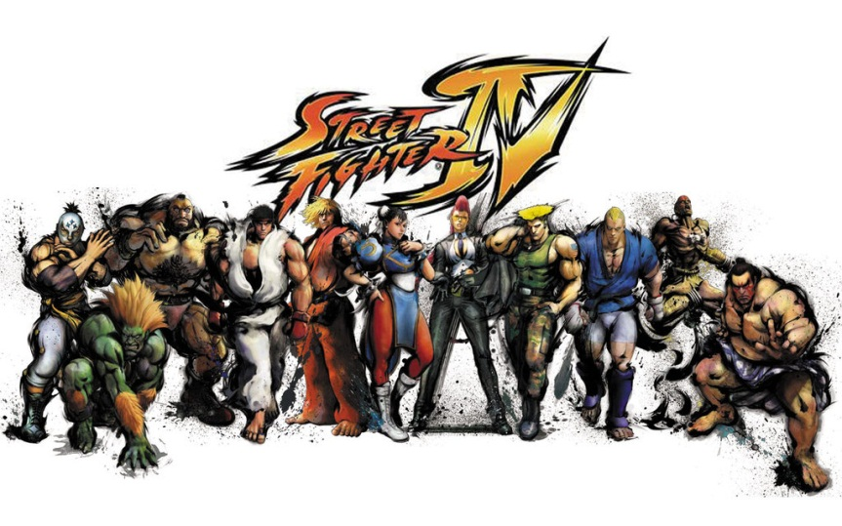
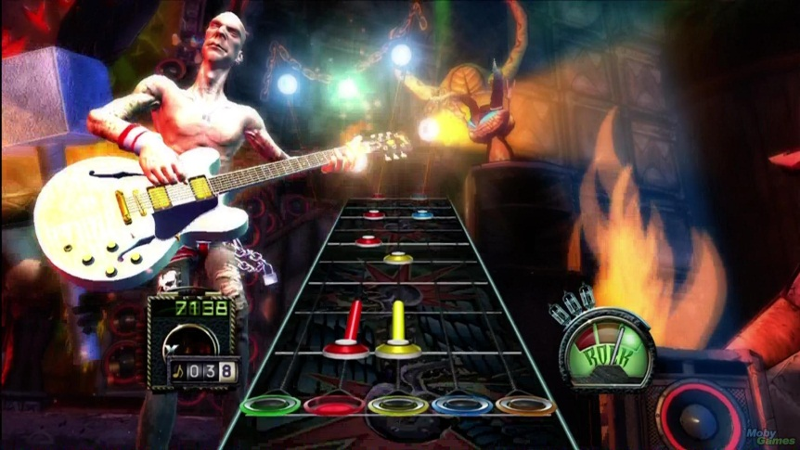
Core Statements
"The game is about"
"The game is the experience of being..."
"The game teaches..."
"The game simulates the experience of..."

Slide 11
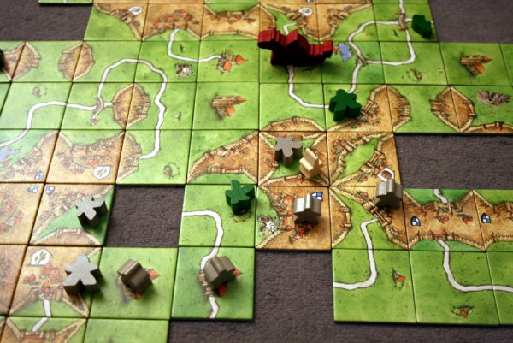
Core Dynamics
Territorial Acquisition
Prediction
Spatial Reasoning
Survival
Destruction
Building
Collection
Chasing/Evading
Trading
Race to the End

Slide 12
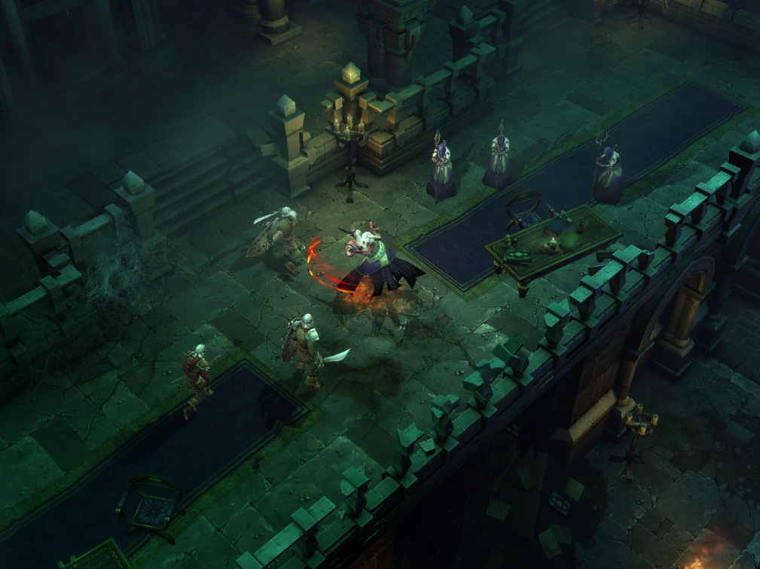
Lab
Analog game prototyping – Diablo-like game

Slide 13
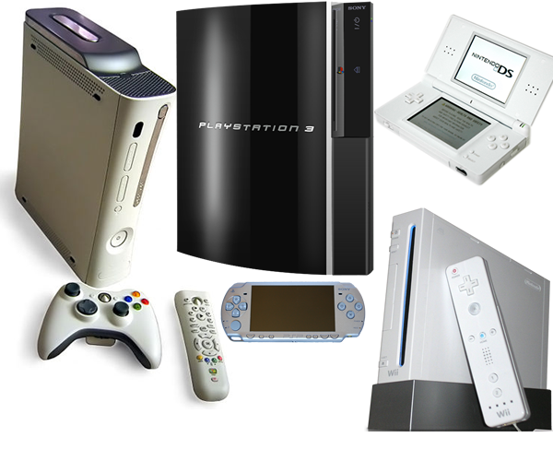
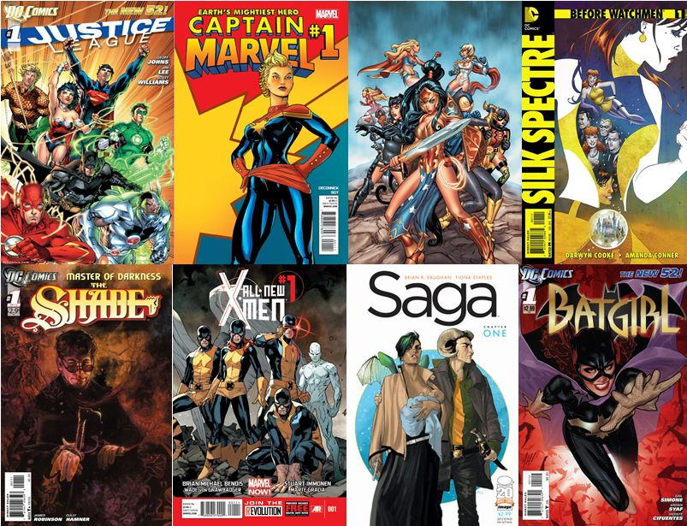


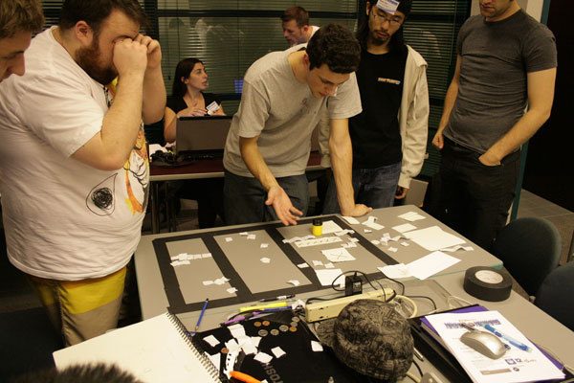
Where do ideas come from?

Slide 14
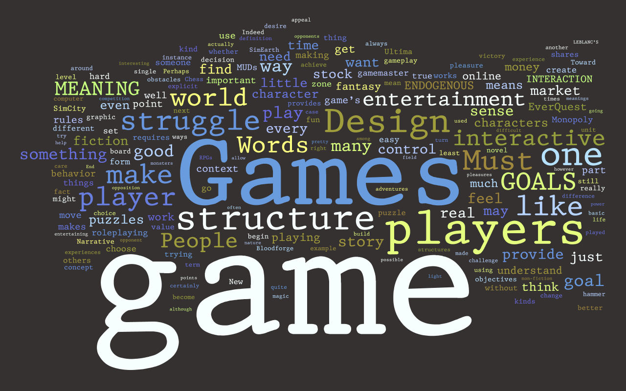
Common Terms
Feature list
Brainstorming
Prototype
Balance
Mechanics
Dynamics
System
Avatar
Playtesting

Slide 15
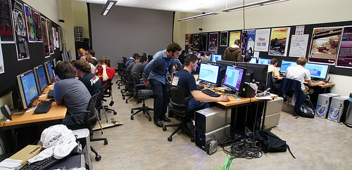
Common Terms (Digital games)
Platform
Concept doc
Proposal
Pitch (Elevator pitch)
Design document
Bugs
Engine
Alpha
Beta
Gold
Game Jam
Milestone

Slide 16
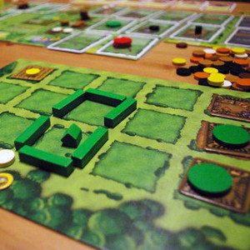
Common terms (non-digital)
Game Bits
Card Game
Board Game
Tile Game
Dice Game

Slide 17
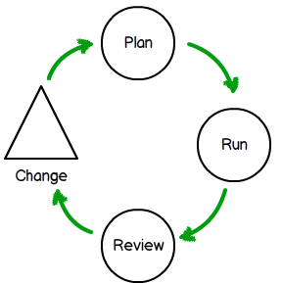
Iterative Game Design
1. Prototype
Make a prototype rapidly
2. Playtest
Partial or full
3. Revise
Fortify weaknesses and build on strengths
4. Repeat
Go back to the prototype and start the next iteration

Slide 18
Lab
Analog Prototyping – Round 2

Slide 19
Constraints on game design (Digital)
Approximate budget
Desired time frame
Desired Platform (consoles, multiplayer console, phone)

Slide 20
Constraints on game design (Non-Digital)
Cost to manufacture per unit
Physical dimensions (board, tabletop, small/large pieces)
Publisher
Timing

Slide 21
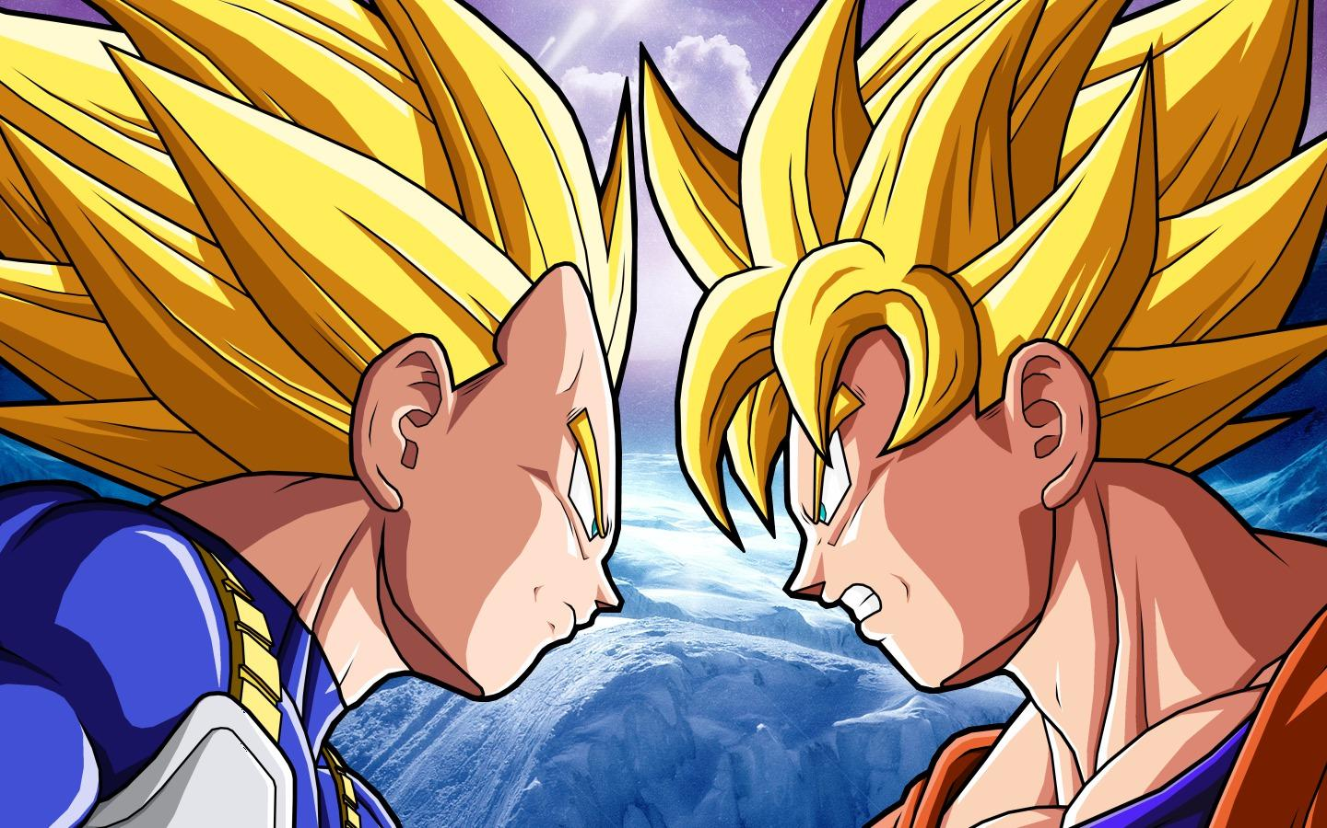
Publisher/Developer Cycle
What does the publisher do exactly?
How does iterative game design play into the publisher/developer cycle?
The game design cycle in the real world
Cutting features

Slide 22

“Perfect” gameplay vs “Great” gameplay
We would like to make the perfect game, but that would take forever…
How can you be happy with 'just' a 'great' game?

Slide 23
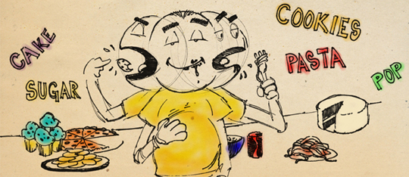
Overcoming Designer’s Block
Make a resource limited or unlimited
Introduce more interaction, allowing players to affect one another
Mess with the play order
Kill a rule
Use a rule of two (double or halve a resource)

Slide 24
Homework
Read: http://www.gamasutra.com/features/20060508/henderson_01.shtml
Read:http://www.gamasutra.com/view/feature/130814/the_siren_song_of_the_paper_.php
Homework assignment for Week 2 – Combat game

